Slide 1
Chapter 13
Logistic Regression

Slide 2
Comparisons:
Linear regression: relationship between continuous quantitative response variable and set of predictor variables
Logistic regression: relationship between dichotomous (binary) response variable and set of predictor variables.
target variable:
yes/no
agree/disagree
tests positive/tests negative
churns/does not churn
success/failure

Slide 3

Example: Relationship between presence/absence of disease and patient’s age
Data: 20 patients (1 = disease present, 0 = disease absent)

Slide 4
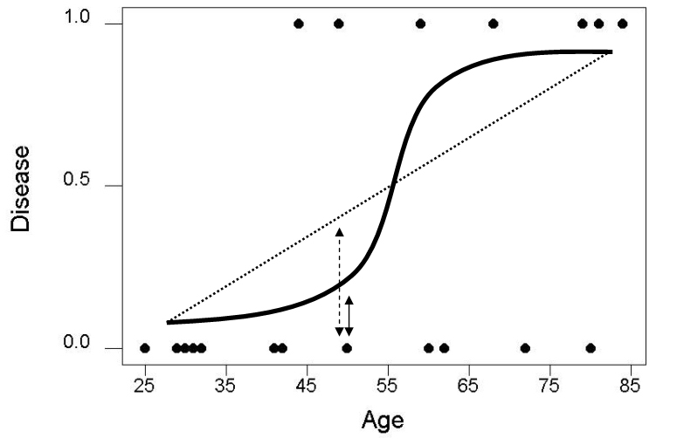
Simple Example of Logistic Regression (cont’d)
Plot shows least squares regression line and logistic regression curve for disease on age
Linear regression: assumes linear relationship between predictor and
response
Logistic regression: assumes
non-linear relationship between
predictor and response
Patient 11 estimation errors (vertical lines) shown
For linear regression (red)
For logistic regression (blue)

Slide 5
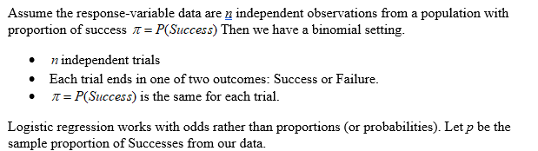

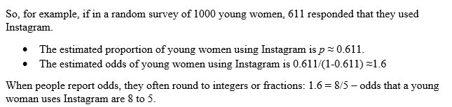
Where does the logistic curve come from?

Slide 6

Need to bring in predictor variable

Slide 7
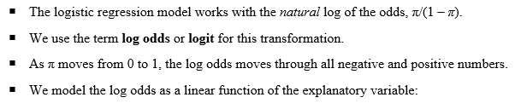

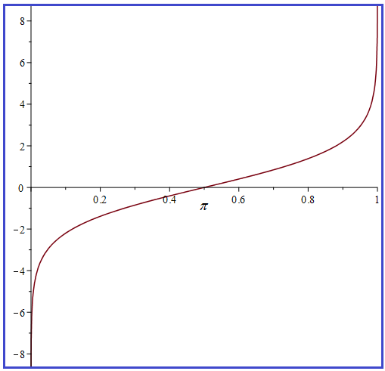

Building Logistic Regression Model

Slide 8



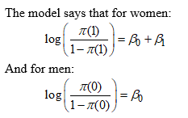
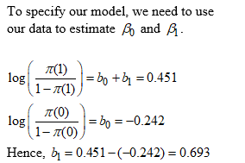
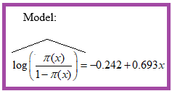
Fitting a Logistic Regression Model

Slide 9
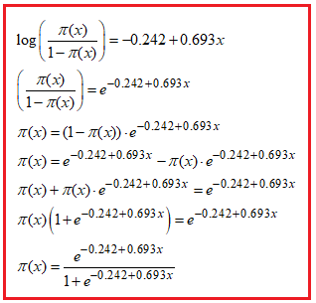
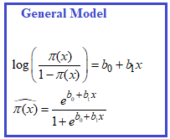

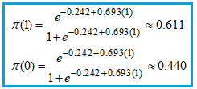
Predicting the likelihood of success: Instagram Example

Slide 10
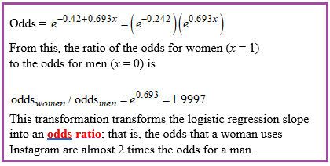
Interpreting Logistic Regression Slope: Instagram Example
Most people are not comfortable thinking in the log(odds) scale, so we apply a transformation.
The exponential function (e^{x}) is the inverse of log(x) (i.e., ln(x)) – Back to odds.

Slide 11
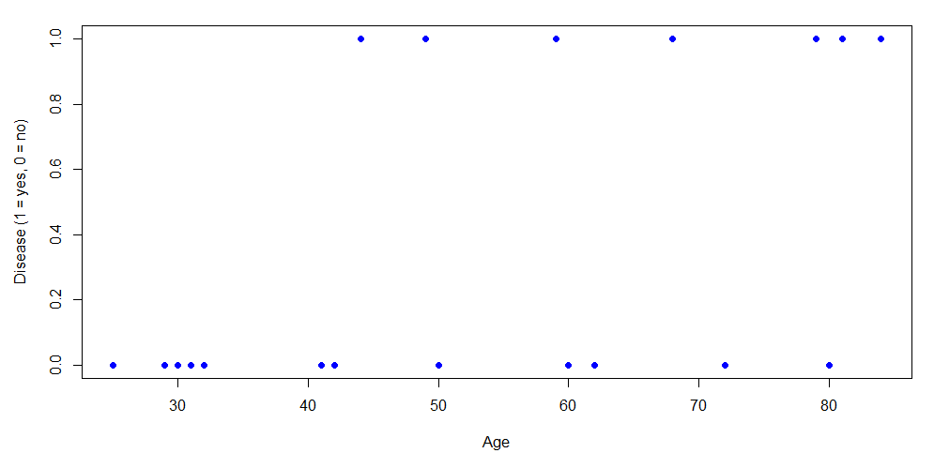
Return to Disease, Age Data

Slide 12
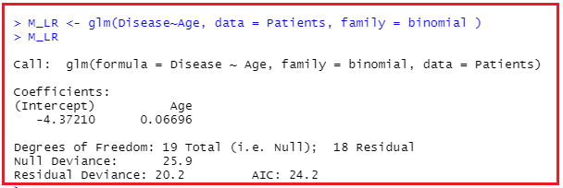
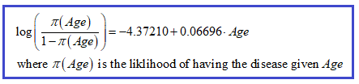
Fitting the Logistic Regression Model
Estimated
logit

Slide 13

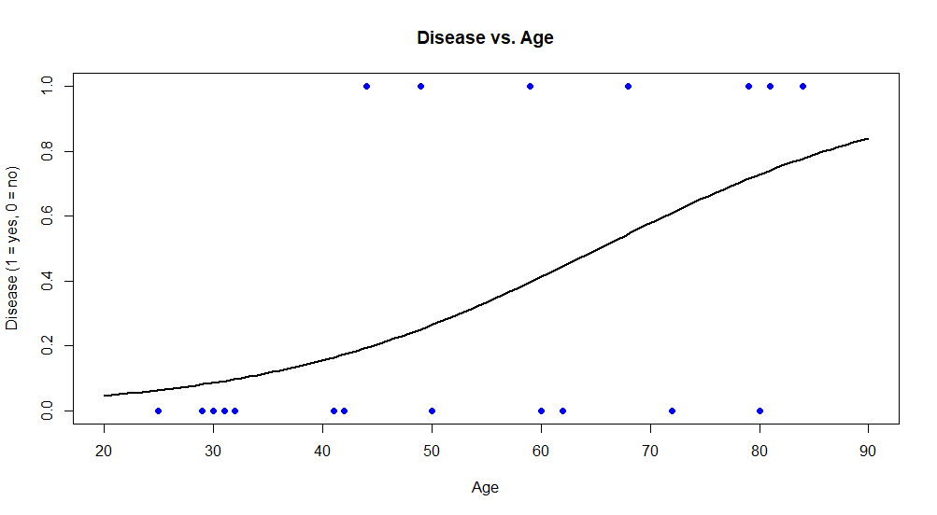
Plot of Model

Slide 14
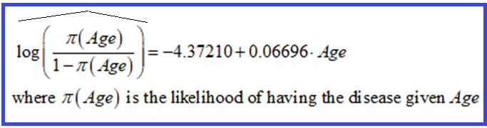
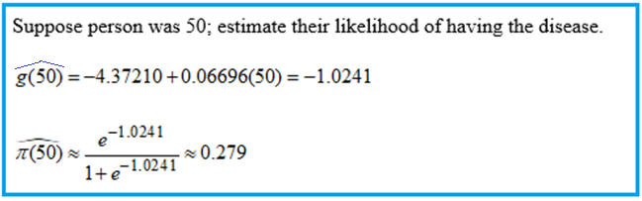

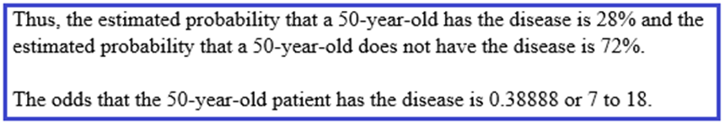
Interpreting Logistic Regression Output

Slide 15

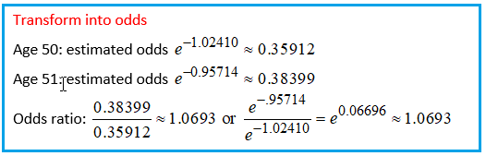
Interpretation of Slope: log(odds) = - 4.37210 + 0.06696(Age)
If Age increases by one year, we expect the log odds of having the disease will increase by 0.06696. This is not meaningful to most people. (Let’s check this out.)

Slide 16
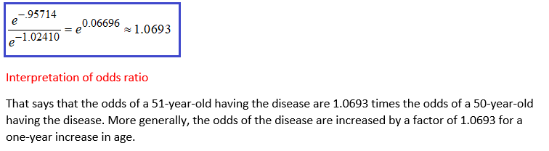

Interpreting odds ratio

Slide 17
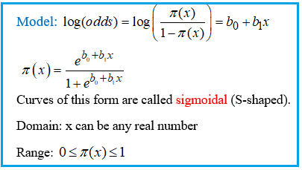
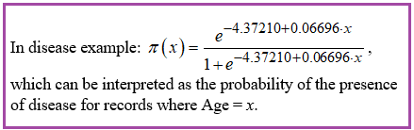
Reminder: Transforming logit model

Slide 18
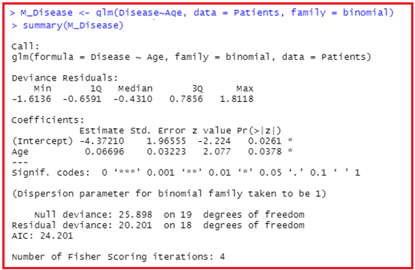

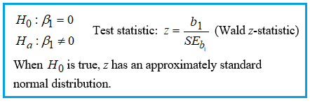
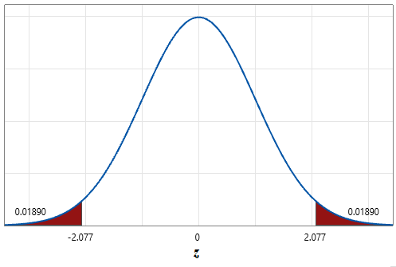

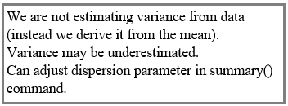
Return to fitting the model in R

Slide 19




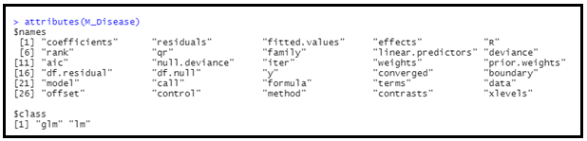
Summary(M_Disease) (continued)
1-with(M_Disease,deviance/null.deviance)
Like SSE
Like SST

Slide 20
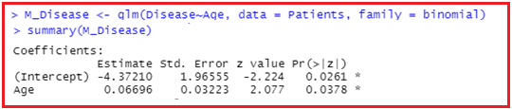

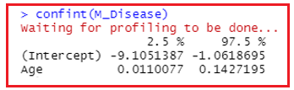
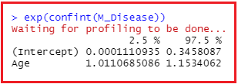
Confidence interval for population slope
Note: Does not contain 0.
Interpretation?
Note: Does not contain 1.
Interpretation?

Slide 21
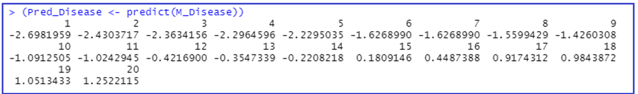
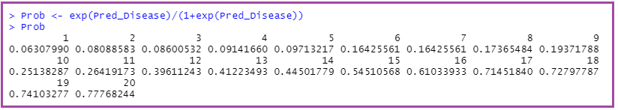
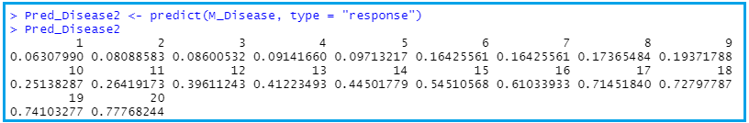
Making Predictions

Slide 22
Next Time . . .
Classification
Evaluation of model

